Slide 1

What Movies get the best Return on Investment?
The Talent: Amanda, Dante, Ped & Richard

Slide 2

The Plot (Motivation)
Can we determine what the best type of movies to make based on a number of factors compared to ROI?
Movie Rating
Genre
Critic Ratings vs Audience Ratings
Runtime
Choose since the data was readily available and how most individuals look at movies before seeing them

Slide 3
Story Board (Data Sources)
A Rotten Tomatoes CSV file with Movie Name, Ratings, Genres, Year, Runtime, Critic and Audience Ratings – found on Kaggle.com
The Numbers website that had the movies budget and domestic gross revenue - www.the-numbers.com
Had to manually screen scrape the data
Used excel to get only movies with a domestic gross above $10M
Took 1999-2018
Rotten tomatoes didn’t have much for 2019 and wanted a full 20 years

Slide 4
Cut & Editing (Data Cleansing)
Merged both CSV’s into a single data frame based on movie title & year
Had to alter movie names to get a match i.e Episode vs Ep.
Unified column headings
Dropped the 2 NR rating movies
Dropped columns we weren’t using for analysis
Removed those that didn’t have a run time or rating, to not skew the averages or counts

Slide 5

ACT 1: Movie Rating Analysis

Slide 6
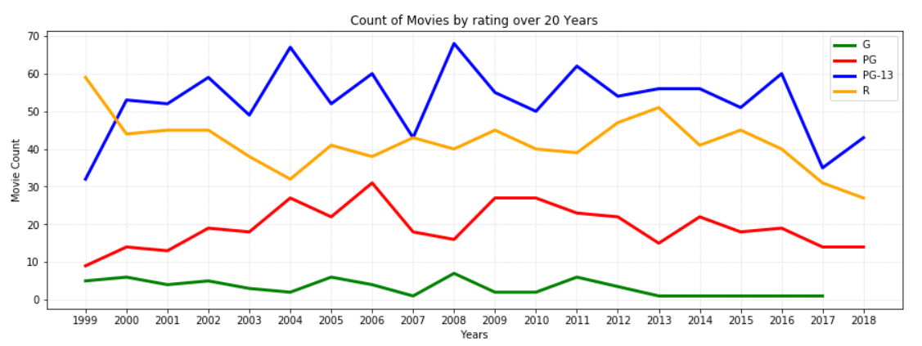
Compare of movies, by rating and year

Slide 7
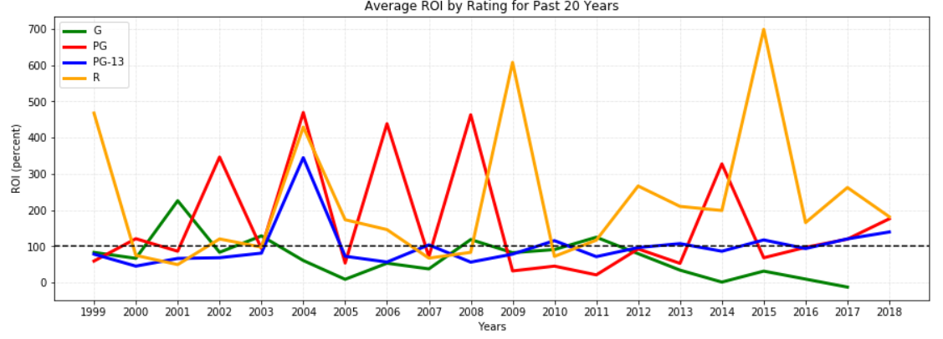
Compare of movies, by ROI and year

Slide 8
Findings
More PG-13 and R rated movies created
ROI fluctuates highly depending on year
PG and R rated movies have better return on investment overall
Based on Ratings alone the number of R rated moves and the average ROI is much high and indicates R rated movies are the best investment

Slide 9
ACT 2: Genre Analysis

Slide 10
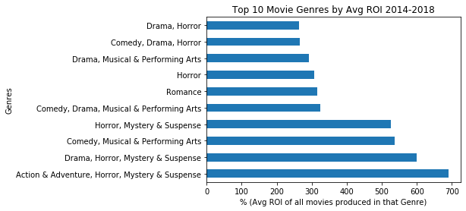
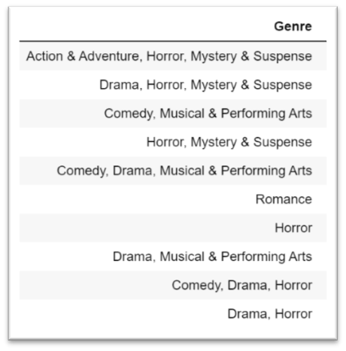
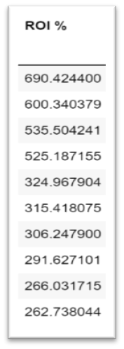
Top 10 Movie Genres with Highest Avg ROI

Slide 11
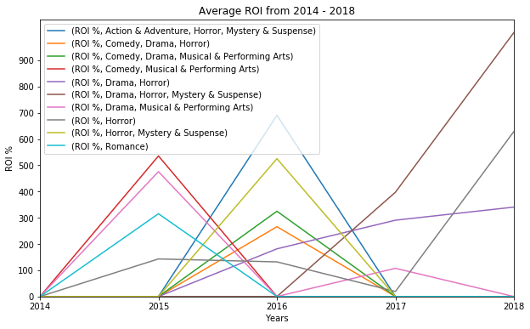
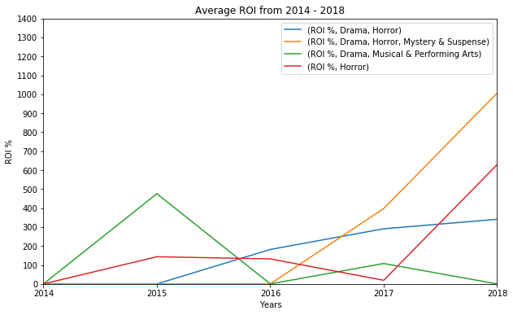
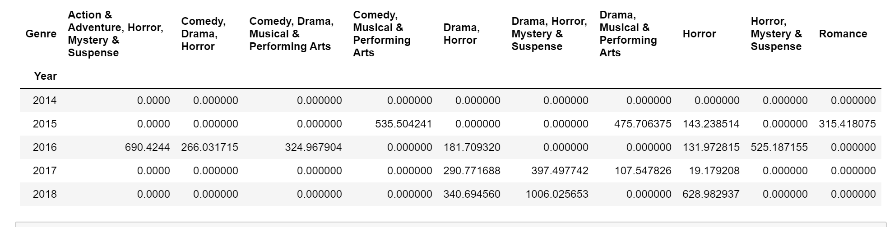
Top 5 Movie Genres with Highest Avg. ROI Over Time(2014-2018)

Slide 12
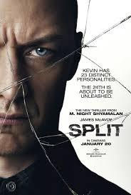

Findings
“Action & Adventure, Horror, Mystery & Suspense” has the highest Avg. ROI % (690%), the 2nd highest Avg. ROI % Genre Category ,“Drama, Horror, Mystery & Suspense” (600%)
“Horror” & “Drama, Horror, Mystery & Suspense” are the most consistent genres, from 2016 to 2018 with having high avg. ROIs.
Based on the findings “Drama, Horror, Mystery & Suspense” movies (ie. ‘Split’, ‘A Quiet Place’) and “Horror” (ie. ‘The Nun’, ‘Annabell’) and Horror movies overall in are the best investment because of their high avg. ROI and consistent yearly high avg. ROI.

Slide 13
ACT 3: Critic vs Audience Rating Analysis

Slide 14
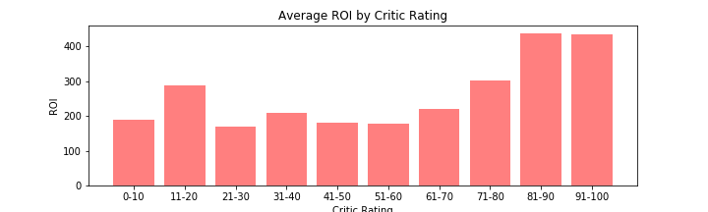
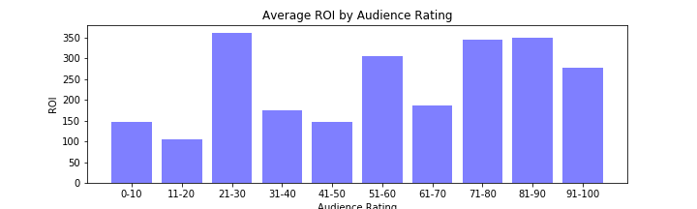
Critic and Audience Rating comparison

Slide 15
ACT 4: Runtime Analysis

Slide 16
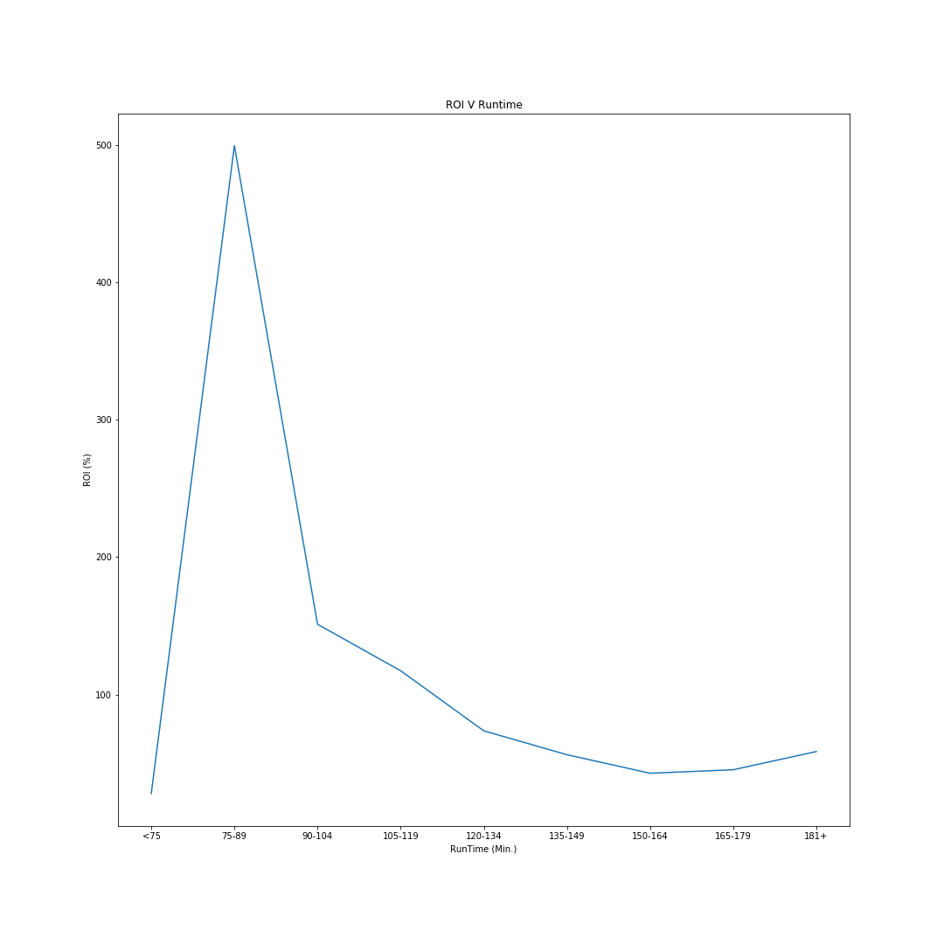
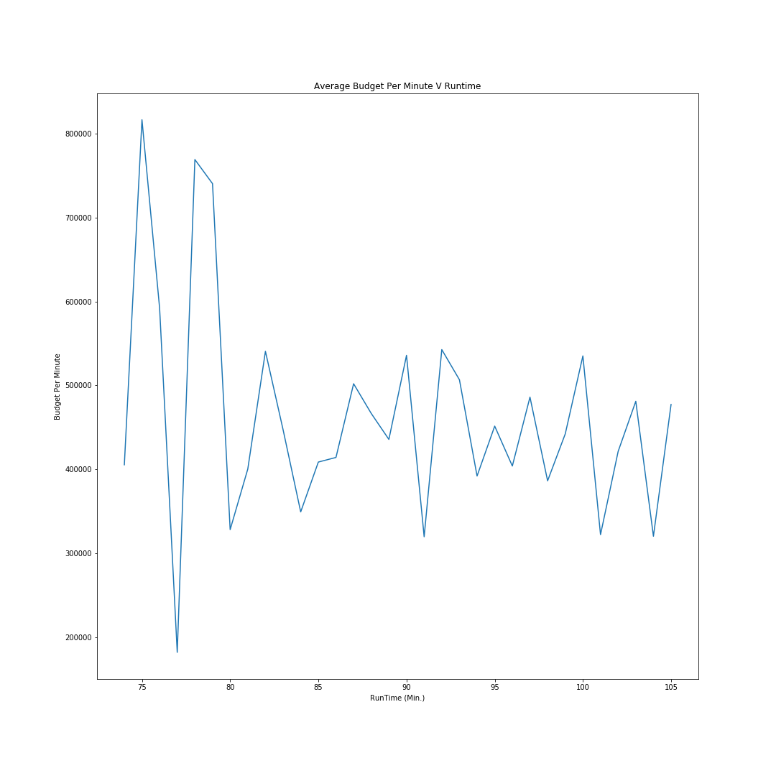
Runtime vs ROI & Budget

Slide 17
Overall Analysis

Slide 18
Complete Conclusion
Based on the analysis ran the best criteria to generate the best ROI for movies:
R rated
Drama, Horror, Mystery & Suspense
Critic Rating between 80-100
Audience Rating between 70-90
Run time close to 90 minutes

Slide 19
Post Mortem
Wanted to include movie awards, but removed due to timing
Data source issues, the API’s didn’t have everything, had timing/count issues so found the Rotten Tomatoes on Kaggle – relying on someone else’s research/accuracy
Would like to have reviewed in more depth:
Why the movie rating versus the ROI fluctuated year over year?
Were there other factors influencing the ROI?
Does plot have any significance?

Slide 20

Q & A

